Slide 1





KESAPIAN
Bryan Valentino Wijaya - 2702301395
Cladio Bernard Octaviano - 2702362876
Kevin Jeremia - 2702292932
Marco Bennedict Makin - 2702336631

Slide 2


PROJECT OVERVIEW
Project goals & objectives:
membuat aplikasi web khusus untuk para Introvert agar mereka dapat berteman dengan orang-orang di sekitar mereka.
Target Audience:
mahasiswa, siswa sekolah menengah, dan pekerja sosial yang mengalami kesulitan menemukan teman di lingkungan baru

Slide 3
PROJECT OVERVIEW
Project scope
Profile Page, pengguna dapat mengatur preferensi, nama, dan privasi akun.
Near Me, fitur ini memungkinkan pengguna mengetahui perkiraan jarak antara mereka dan pengguna lain.
Conversations Starters, fitur ini memungkinkan pengguna yang memiliki masalah dalam memulai percakapan.
Chat, fitur ini memungkinkan pengguna untuk berkomunikasi dengan pengguna lain.

Slide 4
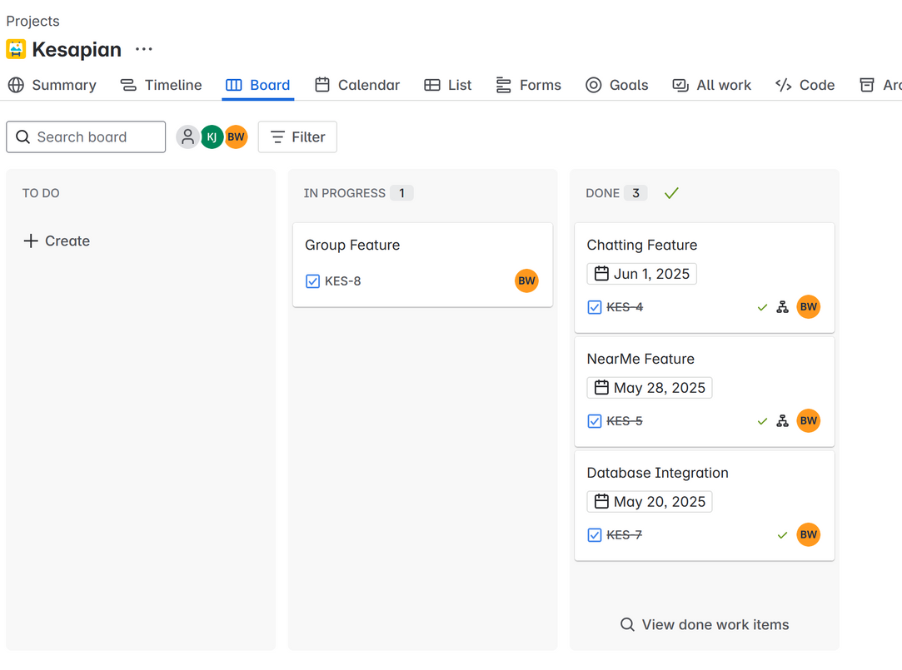
SDLC
Dalam project Kesapian ini, Agile Methodology yang kita gunakan adalah Kanban.
Dalam konsep Kanban ini kita menggunakan sebuah visual Workflow board

Slide 5
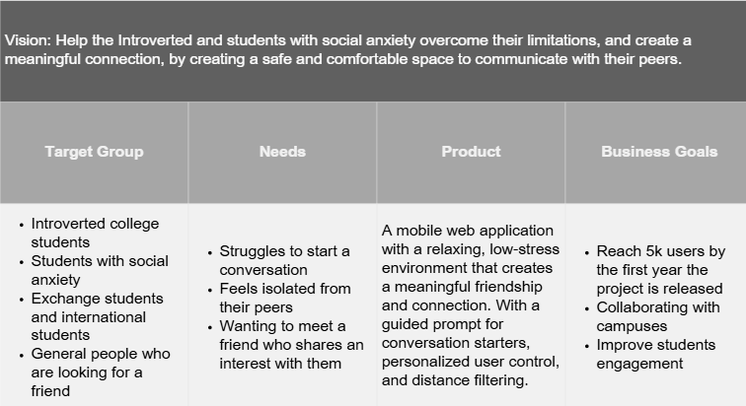
PRODUCT VISION BOARD

Slide 6
CHALLENGES AND SOLUTIONS
Tantangan yang kita hadapi dalam mengerjakan project ini adalah :
Time Management.
Lack of Experience
Solusi yang kita lakukan adalah :
Manage and work according to our timeline.
Search and Apply

Slide 7
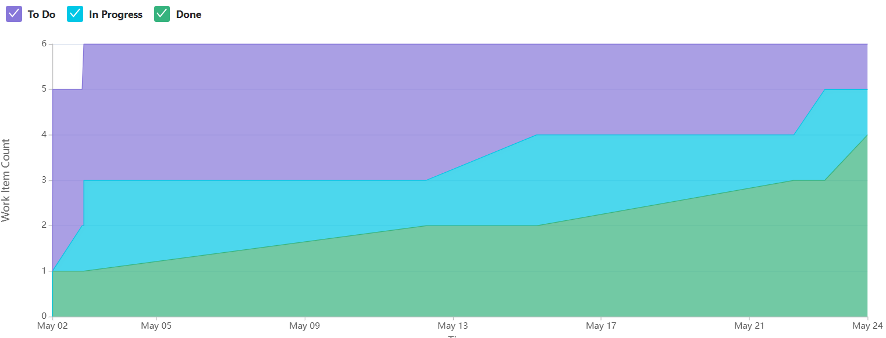
VELOCITY CHART

Slide 8
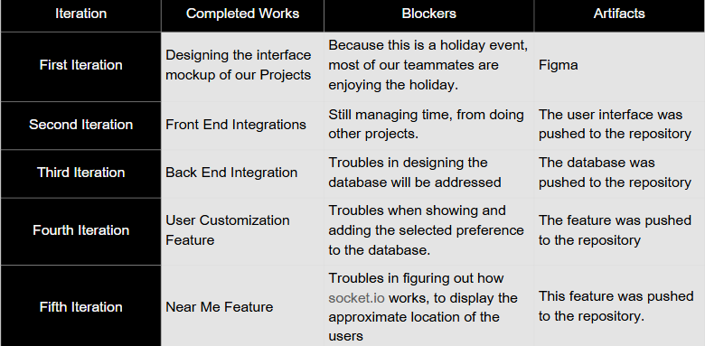
KANBAN SUMMARY

Slide 9
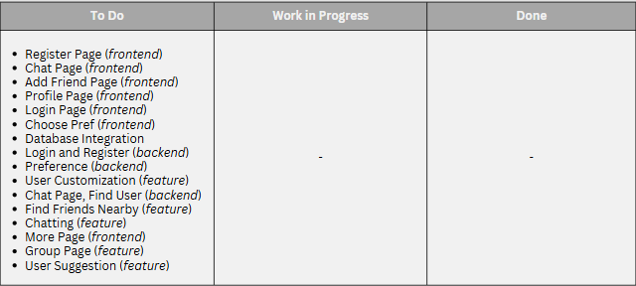
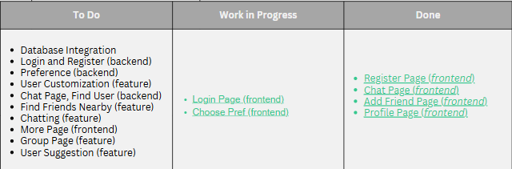

KANBAN ITERATION
ST
1

Slide 10
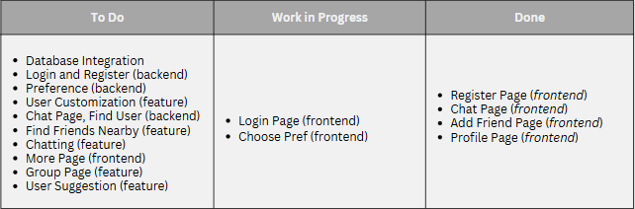
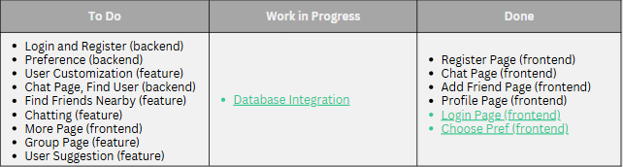
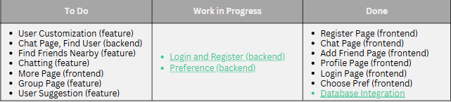
ND
2
RD
3

Slide 11
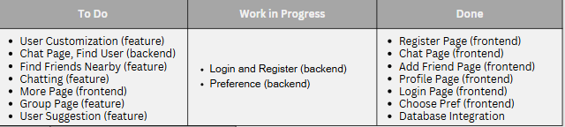
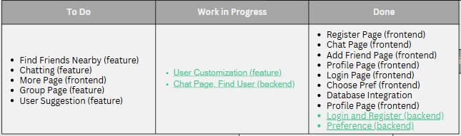
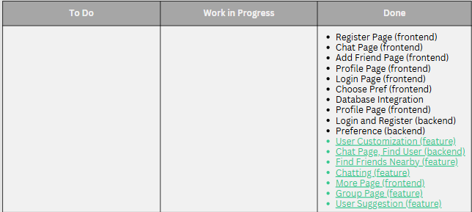
TH
4
TH
5

Slide 12

LESSON LEARNED
Time Management : hal yang kita pelajari adalah, time management merupakan kunci untuk mengerjakan projek ini.
Different Background : Setiap anggota di kelompok ini memiliki skill yang berbeda-beda dan pengalaman yang berbeda-beda dengan yang lainnya.

Slide 13
FINAL PRODUCT DESCRIPTION
User Log In and Register
Description
Allows the user to create an account and log in to that account, whilst choosing their preference when they have just created their account or registered it.
Size = M
Priority= Must Have
DoR
The user database is already built
Database integration is successful
UI is already designed
DoD
The user can create a profile, and the created profile will be saved to the database.
The user can log in to the created account.
-

Slide 14
FINAL PRODUCT DESCRIPTION
Chat Feature
Description
This feature allows the user to communicate with other users and create friendships on the platform via an Asynchronous system.
Size = XL
Priority = Must Have
DoR
The integration of the database is successful
The UI is already built
User authentication is completed
DoD =
The user can communicate with another user, whether it’s receiving or sending messages.
Chat notification is optional.

Slide 15
FINAL PRODUCT DESCRIPTION
Near Me feature
Description = This feature allows the user to know another user nearby, so that they can select the user and create a plan to do something in real life
Size = L
Priority = Must Have
DoR
The Add Friend UI is built
DoD
The user can see another user who’s near their location, with the approximate distances.
The user can add and chat with other users who are near their location
The user whose distance is more than 5km will not be shown in this feature

Slide 16
FINAL PRODUCT DESCRIPTION
User Customization
Description: Allows the user to change their username, password, toggle their location to be shown or not, and change their preferences.
Size = M
Priority = Must Have
DoR
The login and register system is fully developed
The design or the UI of the user Profile page is completed
DoD
The user can set their location as “private,” which means that no other user can see their current location, or “Public”, which allows the user to know the location of the user.
The user can select and change their preferences, and the change will be saved in the database.
The user can change their old password to the new one.
The user can change their username.

Slide 17
FINAL PRODUCT DESCRIPTION
Conversation Starters
Description = Allows the user to select and send various prompts for conversation starters listed above, where the user types their messages.
Size = M
Priority = Should Have
DoR
The chat feature is fully developed
The add friend feature is fully developed
DoD
The user can select and send the prompt listed above their place to type

Slide 18
FINAL PRODUCT DESCRIPTION
Add Friend
Description = Allows the user to add their friend, either by email or by username. And list the added friend on the homepage.
Size = L
Priority = Must Have
DoR
The database is integrated into the software
There is more than one user in the app
The main or homepage UI is fully developed
DoD
A user befriends another user by adding their username, and the added user will be saved in the database.
A user can befriend another user by adding their email, and the added user will be saved in the database.

Slide 19
FINAL PRODUCT DESCRIPTION
Friend Recommendation
Description = allows the user to see another user who has similar preferences to them.
Size = M
Priority = Should Have
DoR
The database is integrated into the Software
The Add friend page is fully developed
DoD
The user can see the other user who has a similar preference to them

Slide 20
FINAL PRODUCT DESCRIPTION
Blocking Offensive Words
Description = The system will cancel the user submission of text whenever their text contains specific offensive words.
Size = S
Priority = Could Have
DoR
The chat feature is fully developed
The database for the blocked word is developed
DoD
The sent message containing the offensive word will be aborted, and the system will show a warning to the user.

Slide 21
TERIMA KASIH

